Slide 1
Data Screening

Slide 2
Why?
Data Screening b/c it is important to understand the data that you have and it is important to make sure the results that you have are appropriate.

Slide 3
Big Important Rule
For hypothesis testing (t-tests, ANOVA’s regressions, correlations) we look for a p-value of p<.05…because we want the chance of having a type I error to be less than 5%.
For data screening we use a stricter criterion: p<.001

Slide 4
Order
Accuracy
Missing Data
Outliers
Assumptions

Slide 5
Order Cont…
You want to stick to this order because everything you do in one step affects the other steps

Slide 6
Background Information
Participants took an anxiety test to assess their respective anxiety disposition. Then participants were given 5 minutes to read 3 scenarios. Next, participants took a memory test. After the memory test they rated how stressful the memory test was.

Slide 7
Fake Data
Independent Variables:
Gender (categorical)
Anxiety (Continuous)
Stress (Continuous)
Dependent Variable:
Memory (Continuous)

Slide 8
Reminder…
Data screening has the basic steps and rules for any analyses with a few exceptions and those exceptions will be mentioned when we get to assumptions

Slide 9
Accuracy
Check for typos and if minimum and maximums scores are in range

Slide 10
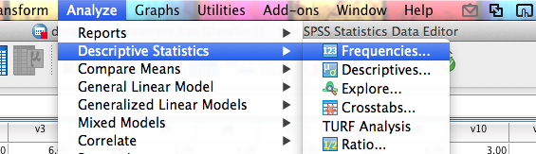
Accuracy Steps
1) Analyze > Descriptive Statistics > Frequencies

Slide 11
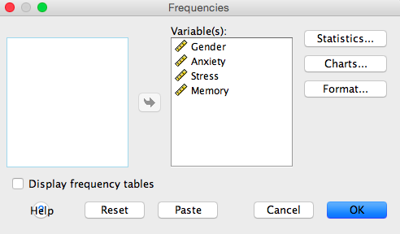
Accuracy Steps
2) Move all the variables you need to check into the variables box.

Slide 12
Accuracy Steps
3) Click statistics and check all the appropriate boxes.
4) Ask for Min, Max, Mean, median, and mode.

Slide 13
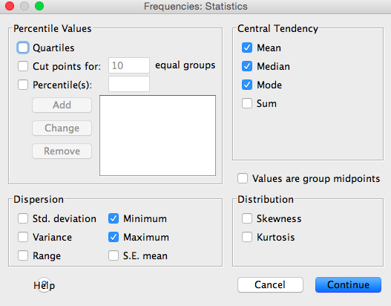
Then hit continue and then okay!

Slide 14
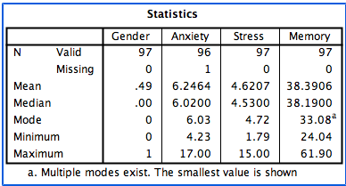
You really only need to look at Minimum and Maximum scores and make sure they are not out of range.

Slide 15
Accuracy
There are two ways to fix your accuracy issues
1) You would go to data view in SPSS and you could select a column/variable and right click and select sort descending (to check your maximum scores) or ascending (to check your minimum scores) or go to data, sort cases, and move the variable you want to check to the box on the right side …you can’t select multiple variables even though it is very tempting then hit sort descending or ascending and then hit okay.

Slide 16
Accuracy
Now, to fix these accuracy issues we could just delete that one spot
Note: Don’t delete the whole role you just want to delete that one spot or the scores that are out of range.

Slide 17
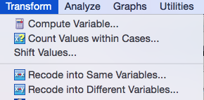
Accuracy
Second way to fix accuracy issues:
Transform>Recode into same variable>

Slide 18
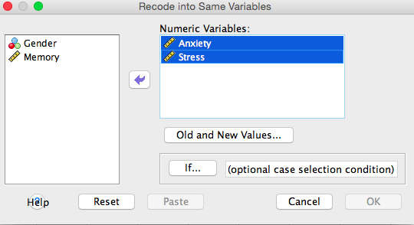
Accuracy
Then,

Slide 19
Note…
If you have multiple variables that need fixing but don’t have the same rules then you would have to fix them separately. For example, if a rule for one variable is 1 to 6 and a rule for another variable is 0 to 8 then you would have to fix them separately but since in our study, anxiety and stress variables, have the same rules (which is 1 to 8) and they are the only ones that need fixing then we can move them both at the same time.

Slide 20
To Fix Minimum Scores
If you have scores that are below your minimum then you want to click “Range lowest through value.” This looks for that value and any values below and it makes those values missing data.
You want to put a value in that is right below your minimum score. For example, if your minimum was 1 then you would want to put .999 in the box because that is say anything < .999 will be made into missing data.

Slide 21
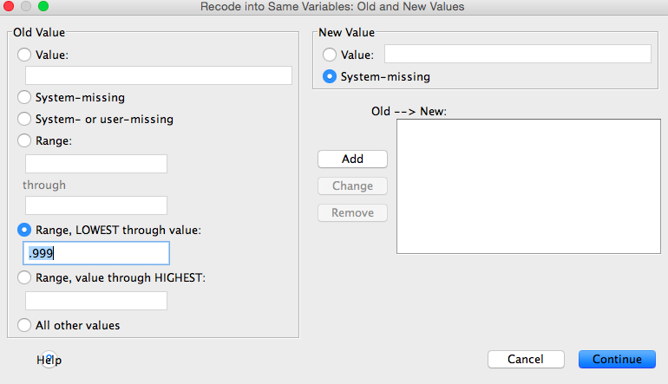
Then hit ADD!

Slide 22
To Fix Maximum Scores
Now to fix your maximum scores you would click “Range, value through the highest.”
So this looks for the value you put in and any values higher than that value and makes those values missing data

Slide 23
Accuracy
So for our study, if there are scores of 8.01 or higher then those scores become missing data which clears out any inaccurate values you may have.

Slide 24
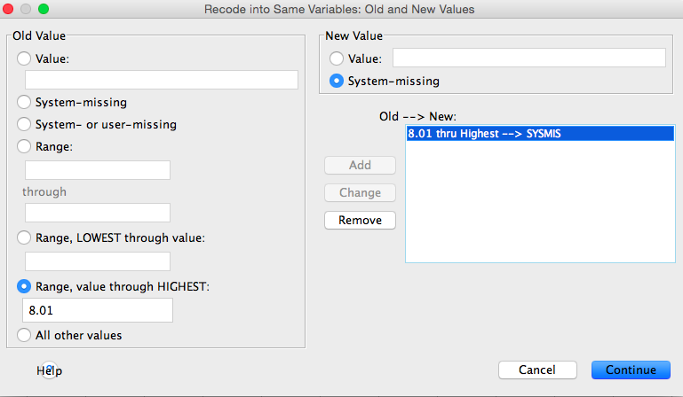

Slide 25
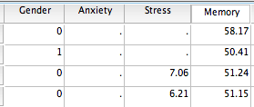

Slide 26
Accuracy
Now, there are two ways to check to see if you accuracy issues have been fixed
1) So for our study, we can look in SPSS data view, sort descending and see that your maximum scores are now missing data…so now you have more missing data than before.

Slide 27
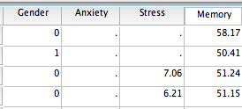

Slide 28
Accuracy
2) You can also go to analyze, descriptive statistics, frequencies, and I just hit okay since everything is still set up from the first time you did it. Now, when you look at your variables’ minimum and maximum scores, you should see that they are in range.

Slide 29
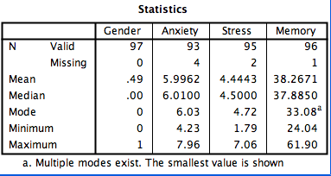

Slide 30
Missing Data
Once you have fixed accuracy issues you see that you have missing data in the statistics box:
Anxiety is missing 4 data points,
stress is missing 2 data points and
memory is missing 1

Slide 31
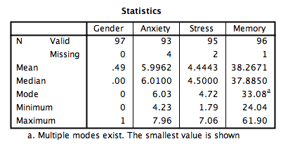

Slide 32
What to Replace?
MCAR – missing completely at random (you want this)
MCAR – probably caused by skipping a question or missing a trial.

Slide 33
What to Replace?
MNAR – missing not at random (eek!)
MNAR – may be the question that’s causing a problem.
For instance, what if several people skip questions about smoking? Well maybe when you look at the question you asked if they smoked or not and then your following question was how often they smoked and you didn’t give them an option to say they didn’t smoke so they just skipped it

Slide 34
What to Replace?
Do not replace categorical variables.
i.e. Gender
Do not replace demographic variables.
i.e. Race, Age, Weight, etc…
Most people replace continuous variables (interval / ratio)

Slide 35
How Much Can I Replace?
The 5% rule applies across (by participant – how much data is the participant missing?) and down (by variable/column – how much of that variable is missing).
Small samples = you may need to collect more data.

Slide 36
Pairwise or Listwise
Pairwise – only excludes participants when they have missing values for that analysis
Listwise – excludes them for all analyses

Slide 37
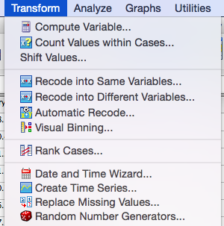
How To Replace Missing Data
Transform> replace missing values

Slide 38
Step 1
Click linear trend at point under series mean
Linear trend at point option – replaces data based on the row average and column average together (i.e. grand mean for the row average and the grand mean for the column average)

Slide 39
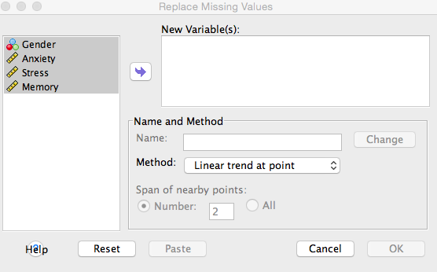

Slide 40
Step 2
Move all the variables that you want to replace to the right in the new variable’(s) box.
I know all my variables don’t have missing data but I am going to highlight everything because the places that are missing are values I can fill in so even though I am highlighting gender there are no places to fill in so it is fine to highlight that column

Slide 41
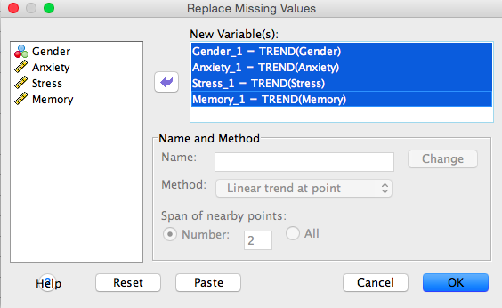

Slide 42
Now What?
Check in the output and see how many data points were filled in.
Look at: “N of Replaced Missing values.” column in the output.

Slide 43
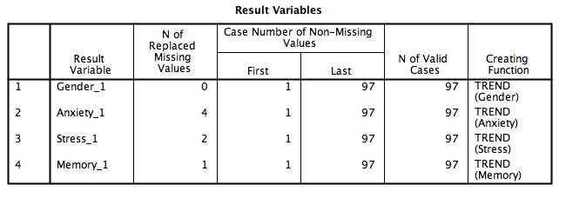

Slide 44
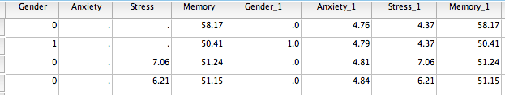
What Happened?
SPSS has created me new variables that are missing replaced.
The first set of variables are my original variables that have missing data and the variables that have a underscore and a 1 are my new variables that have replaced missing data (so no missing data).

Slide 45
Next,
Delete all the variables you had before (so your original variables) and now you have a data set of only the variables where you have replaced their missing data (so no missing data)

Slide 46
Suggestion
Before you do delete any variables you might want to save your original data set and save this one as a new data set so if you mess up you can back to your original data set.

Slide 47
Deleting Variables
Go to variable view in SPSS > highlight the variables you want to delete > click edit > click clear
You don’t have to delete the old variables but I suggest it because it is very easy to accidently use the wrong variables in other steps.

Slide 48
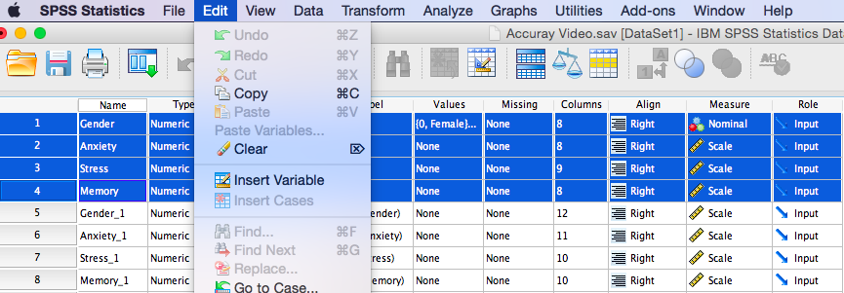

Slide 49
Outliers
What is an Outlier?
An outlier is where a participants has a extreme value(s) on one variable or multiple variables

Slide 50
Two Ways to Check for Outliers
1) Univariate
2) Multivariate

Slide 51
Univariate
Look for outliers in each group, not as a whole
Z-scores – This create z-scores for each group and checks if they are more than 3 standard deviations (same rule as above Z scores of 3 are p < .001).

Slide 52
Univariate
How to check:
Analyze > Descriptive Statistics > Descriptive

Slide 53


Slide 54
Univariate
Then:
Move only the continuous variables over
Be sure to check “save standardized values as variables”

Slide 55
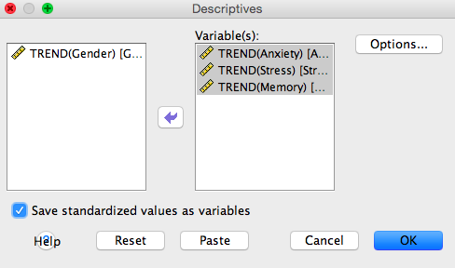

Slide 56
Univariate
It will create these new “z” variables.

Slide 57
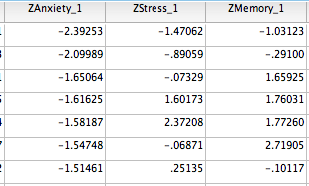

Slide 58
Univariate
Right click > sort ascending
Check for z-scores over +3 or under -3.

Slide 59
OR…
You can go to Analyze> Descriptive Statistics> Frequencies

Slide 60


Slide 61
Then…
Move just the z-score columns over

Slide 62
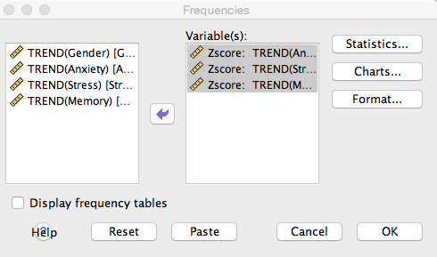

Slide 63
Next…
Click statistics
Check minimum and maximum

Slide 64
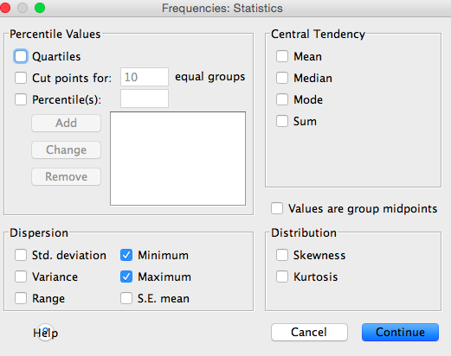
***Then click okay.

Slide 65
Univariate
And you can look at the table in the output and see the minimum and maximum Z-scores that you have for each column so you don’t have to sort ascending and descending for every column.

Slide 66
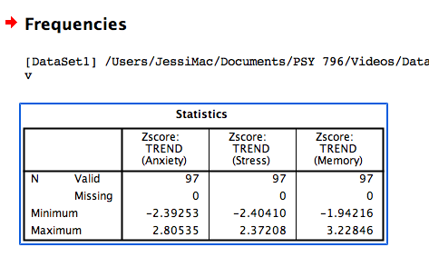

Slide 67
Second Way to Check for Outliers: Multivariate
Do this procedure if you are working with multiple DV’s or with lots of columns.
This gives you an overall picture of the participants without having to look through several columns one at a time and gives you a criteria that says this entire line (so the participant) is an outlier.

Slide 68
Mahalanobis Distance
This is the distance of a case from the centroid of rest of cases. Centroid is created by plotting the means of the all the variables (like an average of averages), and then seeing how far each person’s scores are from the middle.

Slide 69
How to Check
Create Mahalanobis scores (see below).
Hit Transform > compute
Name your random variable
Find a way to compute the random variable
RV.Chisq(pick a number here).

Slide 70
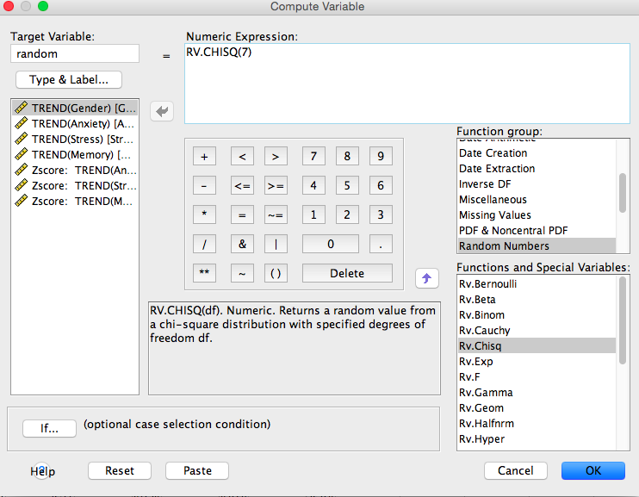

Slide 71
Why Chi-Square
Why chi-square? Because we are going to use the chi-square distribution to determine if those scores are outliers, so we are creating a random variable with the same distribution.

Slide 72
Next…
Now run a fake regression.
Analyze > regression > linear.

Slide 73
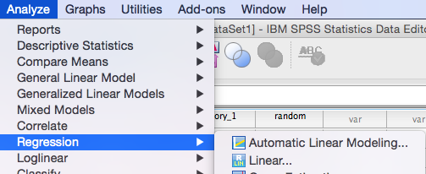

Slide 74
Next…
Move the new “fake variable” random into the dependent box.
Move all the independent variables into the independents box.

Slide 75
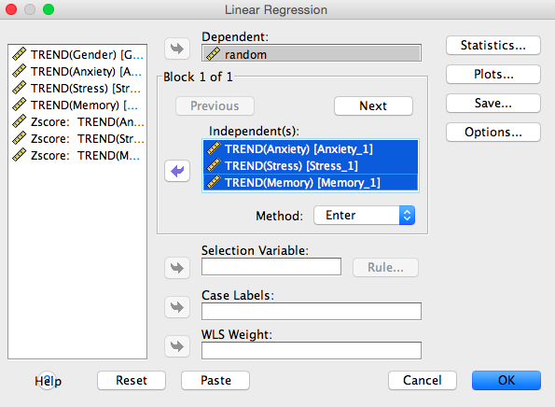

Slide 76
Then…
Click Save.
Click Mahalanobis distance.

Slide 77
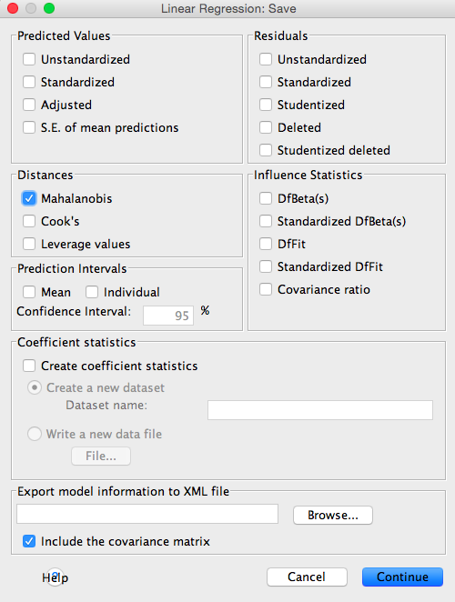

Slide 78

Figure Out the Cut Off Score for Mahalanobis
You will want to use a Chi-Square table for cut off scores. Degrees of Freedom are the number of variables (here we have 3 continuous variables for example). You will use the p<.001 value for cut off scores. This example has a cut off score of 16.27. Therefore, none of the people in this dataset are outliers (because the highest score is 18.93).

Slide 79
Deleting Participants
Delete any participants that have values higher than your cut off score because if you have a mahalanobis distance score that is higher than the cut off score then that means that their entire set of data is screwy…so there distribution of data points is very different from everybody else. Meaning, .001 different, so meaning there is less than 1% that they should be that different so you would delete the entire row (the entire participant).

Slide 80
Deleting People
IF YOU DELETE PEOPLE:
You will have to rerun that fake regression for the plots so they match that you’ve deleted people so you can accurately make assumptions.
DO NOT delete outliers twice.
IF YOU DO NOT DELETE PEOPLE: then the other output/plots you got earlier will be fine to use for assumptions.

Slide 81
Assumptions
Multicollinearity
Normality
Linearity
Homogeneity
Homoscedasticity

Slide 82
Assumptions
Multicollinearity (additivity)
analyze >correlate>bivariate
Check for correlations that are very high (r > .90-.95) or very low (r<.10). Low correlations will be normal.
Very high correlations might give you problems in regression analyses. (low correlations are more of a problem for MANOVA or repeated measures ANOVA).
Rule changes a little bit depending on what analysis you are doing.

Slide 83
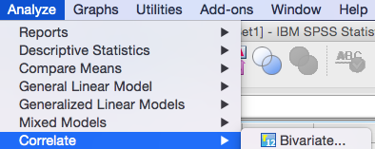

Slide 84
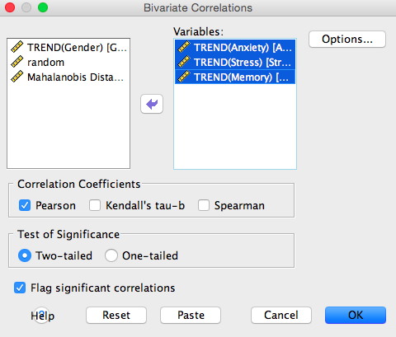

Slide 85
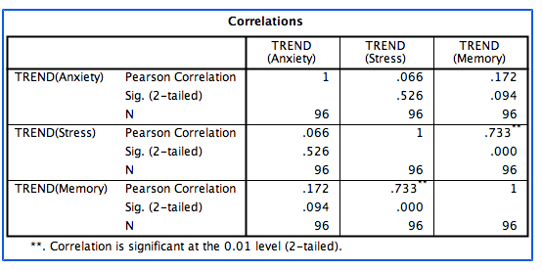
We don’t have any correlations over .9 and since this study isn’t a Repeated Measures ANOVA or a MANOVA then the correlations are fine!

Slide 86
What if?
So, what happens if you have two items that are too correlated?
Then you would want to pick one of them because they are technically not adding anything different to your analysis. So, if you pick one then now you just have that one variable that is adding something instead of having two variables that are adding the same thing to your analysis.
You could also average the two columns together
Whatever way you decide (if you want to average them together or just use one of the columns) then you will have re run the fake regression analysis with the average column or just the one column

Slide 87
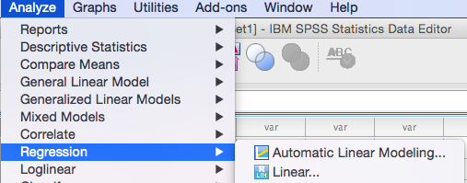
Plots
Analyze > regression > linear.

Slide 88
Then…
Click on plots
ZPRED in Y
ZRESID in X

Slide 89
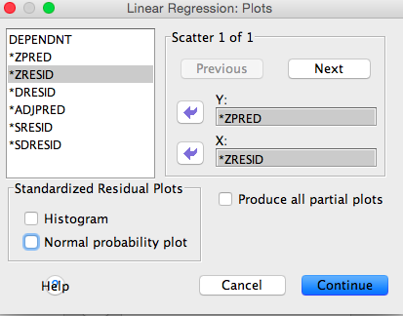

Slide 90
What is going on?
We are creating a scatter plot of the residual values against the predicted values.
ZPRED is the predicted value for the fake regression and this should be random because we are predicting from a random data set.
ZRESID is how different that prediction is from the actual score. So, it is the distance between a persons actual x score and the predicted y score.

Slide 91
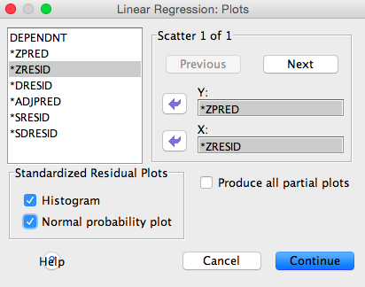
ALSO…
Histogram
Normal Probability Plot

Slide 92
Normality
Univariate Normality
Can check this by looking at each histogram separately for each variable
Multivariate Normality
Look at the histogram where it says random at the top
these are the errors that we want to be distributed multivariate normal

Slide 93
How to check
1) Spread needs to be evenly spread around 0
2) Check the spread of the x-axis
Does it go from -2 to 2 (good) or
-2 to 7 (bad) ?

Slide 94
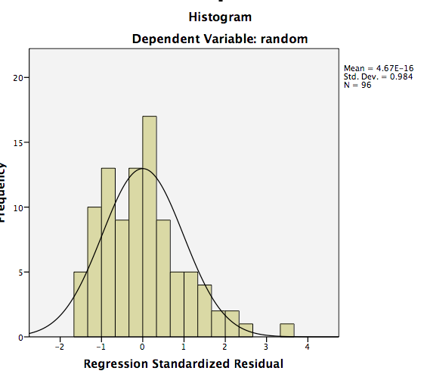
Multivariate Normality Plot
Looks slightly positively skewed!

Slide 95
Multivariate Normality
If you have at least 30 people (central limit theorem) then normality isn’t such as a big of a deal if the assumption is not met.

Slide 96

Univariate Normality
If multivariate normality plot is skewed then I would suggest checking your univariate histograms and see which variable is the problem.
analyze > descriptive statistics > frequencies

Slide 97
Univariate Normality
Move over all your continuous variables
Uncheck the display frequency tables box
Click on charts

Slide 98
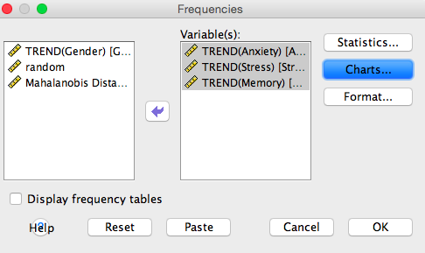

Slide 99
Univariate Normality
Click on histograms
Click on the box where it says “show normal curve on histogram”
Then click continue

Slide 100
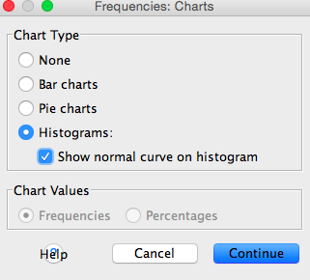

Slide 101
Univariate Normality
Click statistics
Check the skewness box and kurtosis box to help us check for those as well
Then hit continue and then okay

Slide 102
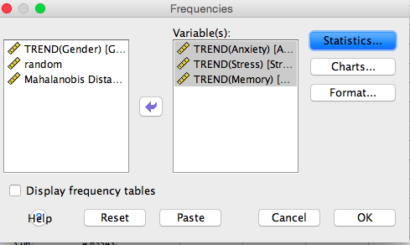

Slide 103
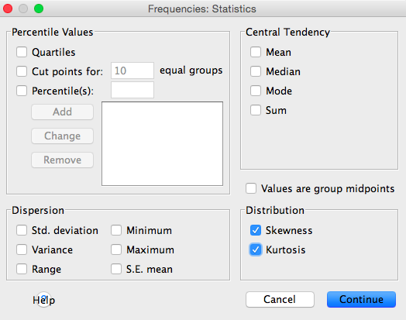

Slide 104
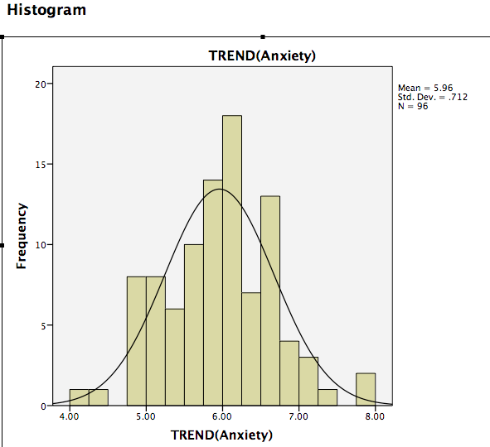
Not normal… We have some people out by 4 and out by 8 and the data is multimodal. Meaning, it has multiple humps

Slide 105
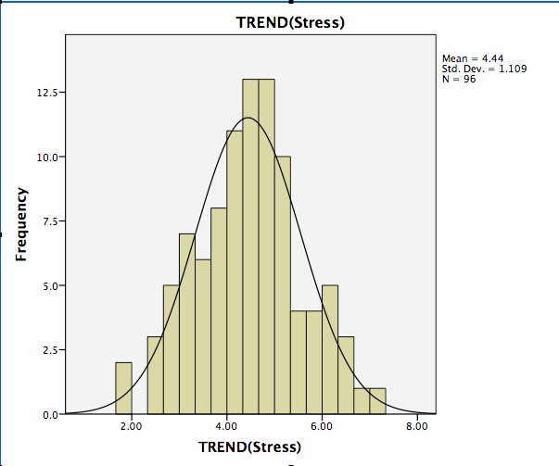
Looks fairly normal…We do have a couple people out by 2 and 7, but for the most part it looks fairly normal

Slide 106
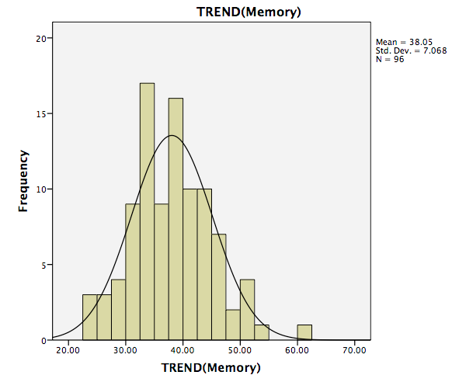
Not normal…because it is bimodal. Meaning, there are two humps

Slide 107
Multivariate Normality
By looking at our histograms for each variable we might see now why our multivariate histogram is not normal.

Slide 108
Also,
Look at the statistics box and look at skewness and kurtosis…
Skewness- how much the distribution leans to the left or to the right
Kurtosis- how skinny or flat the distribution is.
Same rule as z-scores
Values that are greater than the absolute value of 3 are bad
Some of the plots may look bad, but if the values are in the range that we accept as okay (so less than |3|) then the univariate plots are not technically skewed or kurtotic.

Slide 109
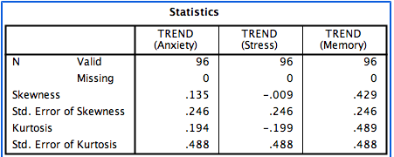

Slide 110
Linearity
For the linearity assumption we want the dots to be fairly close to the line!
Don’t want a curved shape
If you don’t have linearity then you will lose power and then I would suggest trying a non-parametric test

Slide 111
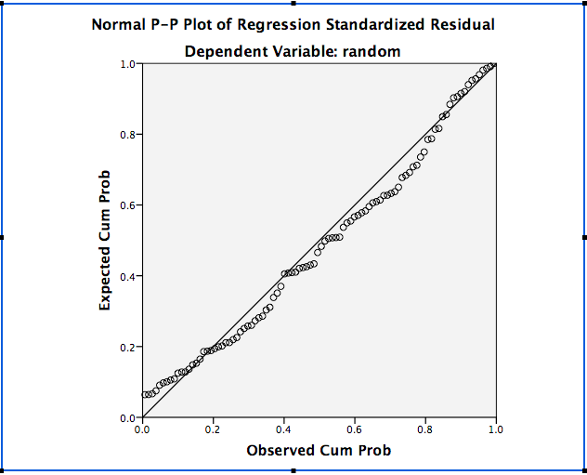
It is Linear!

Slide 112
Homogeneity & Homoscedasticity
This plot is a equal distribution of errors plot…so this is a plot that plots the errors, but the errors should be random so we compared them to a random distribution and that is why we used a random variable to compare this against…so we wanted the errors to be random so we compared them against a random variable.

Slide 113
Homogeneity
Homogeneity means equal variances. So, that means the variance by group is roughly equal

Slide 114
How to check
1) You don’t want to dots to look like they’re raining
2) The spread above and below 0 need to be even for the y-axis and the x-axis.

Slide 115
To Get the Line on Graph…
Double click on the graph
Click where it says “add fit line at total” and then it will automatically give you a linear line
Click close then exit out of that window

Slide 116
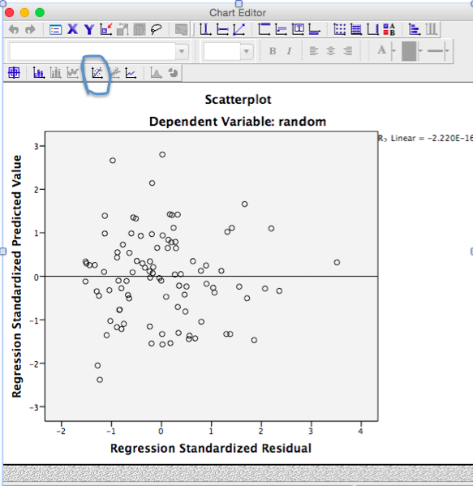

Slide 117
Homogeneity
You want roughly the same amount of dots on the top and the bottom and
You want a equal spread above and below 0. so does it go from -2 to 2 or -2 to 7? However, don’t just look at the numbers, look at how many dots are at each number…so if I drew a line at 2 and – 2, most of the dots are in that range.
Also, look at the plot the other way, so going up. So, looking at your x-axis most of the dots are between 2 and -2 so I would say that this plot is okay.

Slide 118
Homoscedasticity
Are the spread of the dots consistently spread across 0?
If I drew a line around the dots it needs to look roughly circular or look like a blob.
Doesn’t have to be perfect.

Slide 119
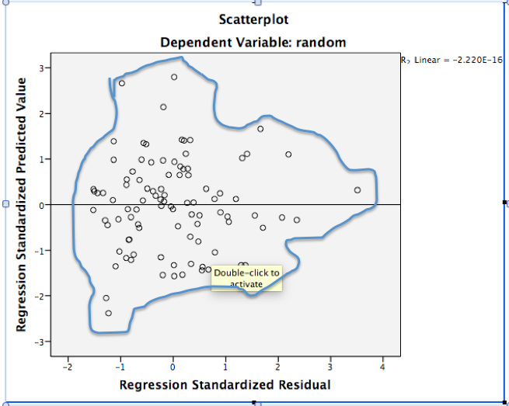

Slide 120
Homoscedasticity
You don’t want is something that looks like a megaphone.
Also, you don’t want a ufo/submarine (so where the spread is small on both ends but large in the middle.

Slide 121
